Slide 1
RESIN Terrorist Attacks Schema Quizlet 9
Iris Liu, Sha Li, Michael Regan,
Susan Brown, Martha Palmer, Heng Ji

Slide 2
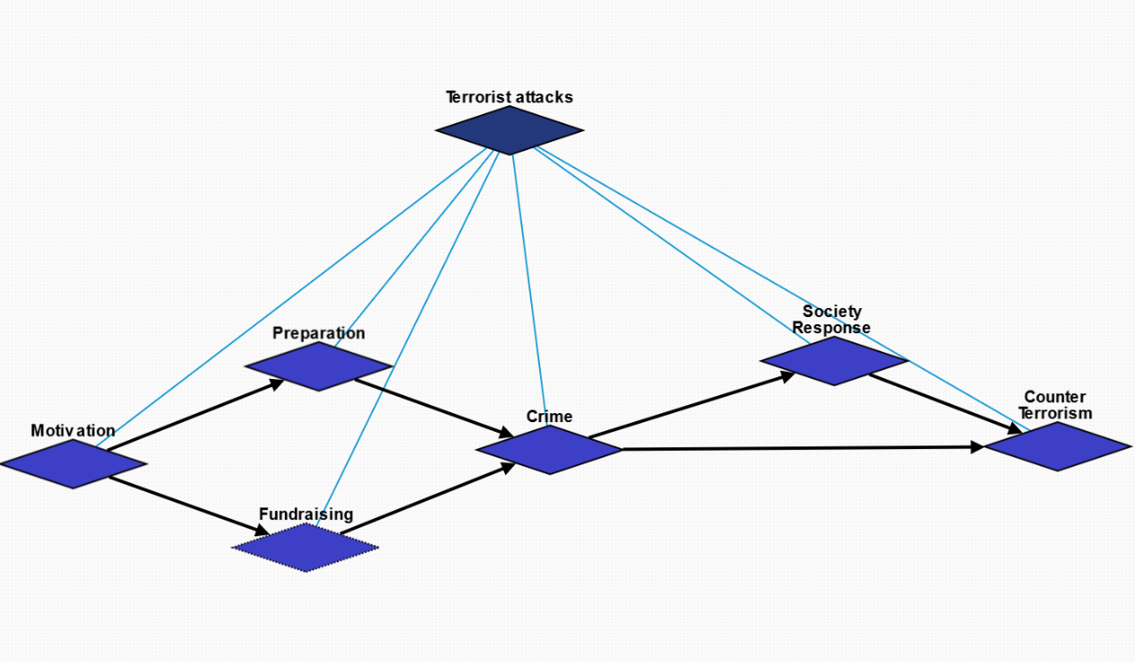
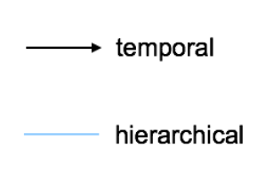
Overview

Slide 3
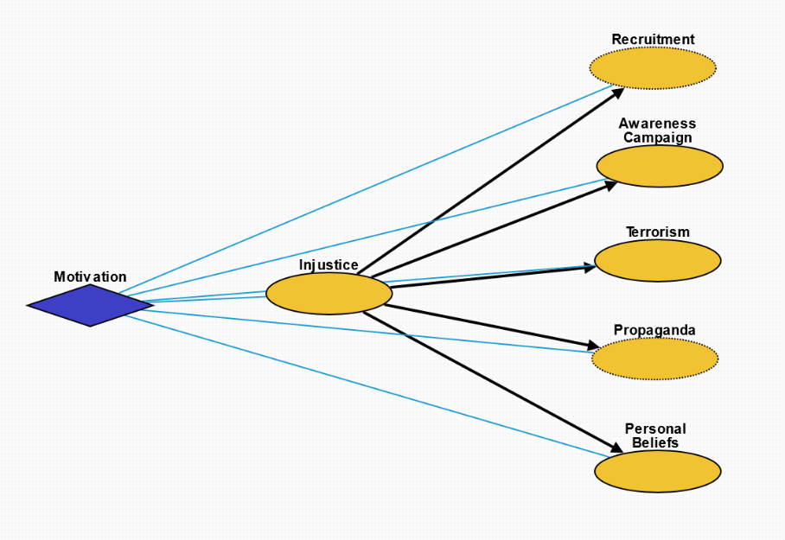
Motivation
Injustice: Injustice, whether objective or perceived, towards a group or individual.
Recruitment: Inspire people to join the cause.
Propaganda: Crime as propaganda to inspire people for the cause.
Awareness Campaign: Raise awareness and receive attention from the media on the cause.
Terrorism: Incite fear in the general population.
Personal Beliefs: Personal beliefs that something about the world is inherently wrong.

Slide 4
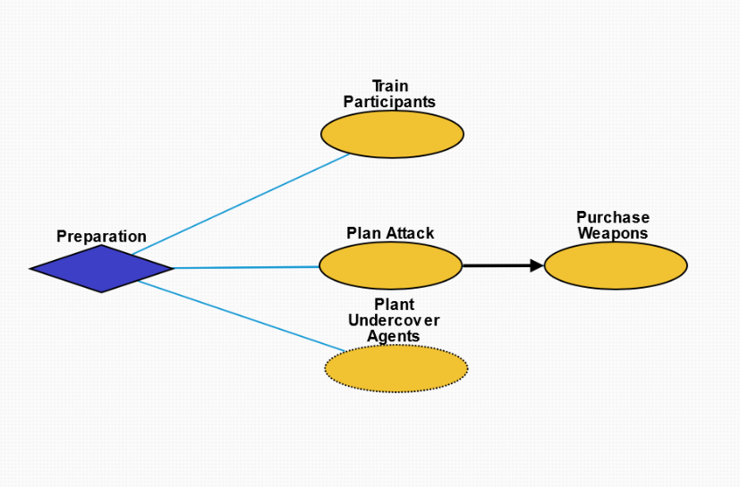
Preparation
Train Participants: Train participants who will execute the attack.
Plan Attack: Plan the specifics of attack.
Purchase Weapons: Obtain weapons for the crime.
Plant Undercover Agents: Plant spies in the target group to obtain information.

Slide 5
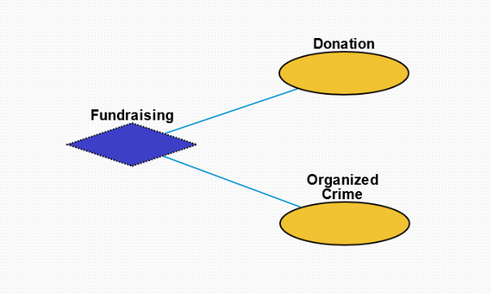
Fundraising
Donation: Monetary donation from supporters.
Organized Crime: Criminal enterprises for the purpose of profit.

Slide 6
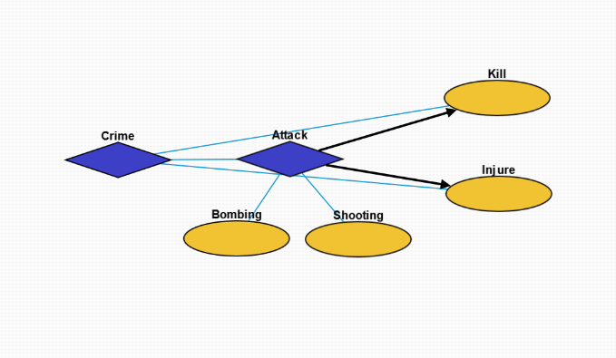
Crime
Attack: Terrorist action to injure another organism.
Bombing: Action whereby a bomb is used to kill one or more people or to damage or destroy objects
Shooting: Act or process of firing firearms or other projectile weapons
Kill: Killing an individual or group.
Injure: Injuring an individual or group.

Slide 7
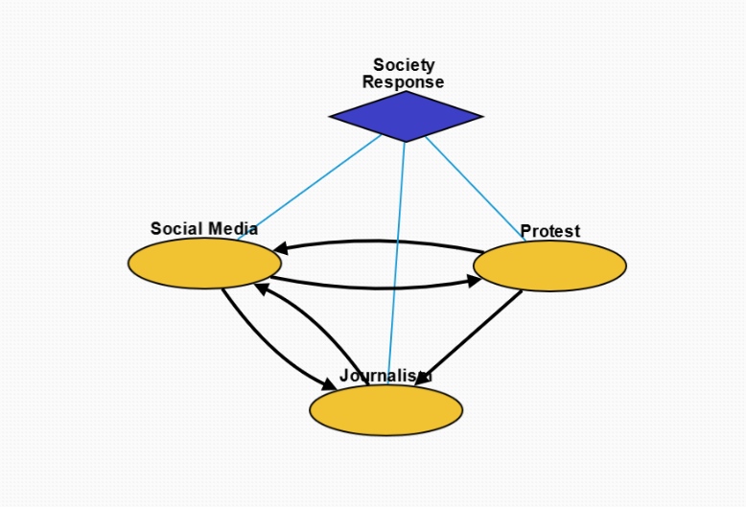
Society Response
Social Media: Interaction among people in which they create, share, and/or exchange information and ideas in virtual communities and networks.
Protest: Collective action by people to protest the terrorist attack and injustice.
Journalism: Investigation and reporting of events, issues and trends to a broad audience.

Slide 8
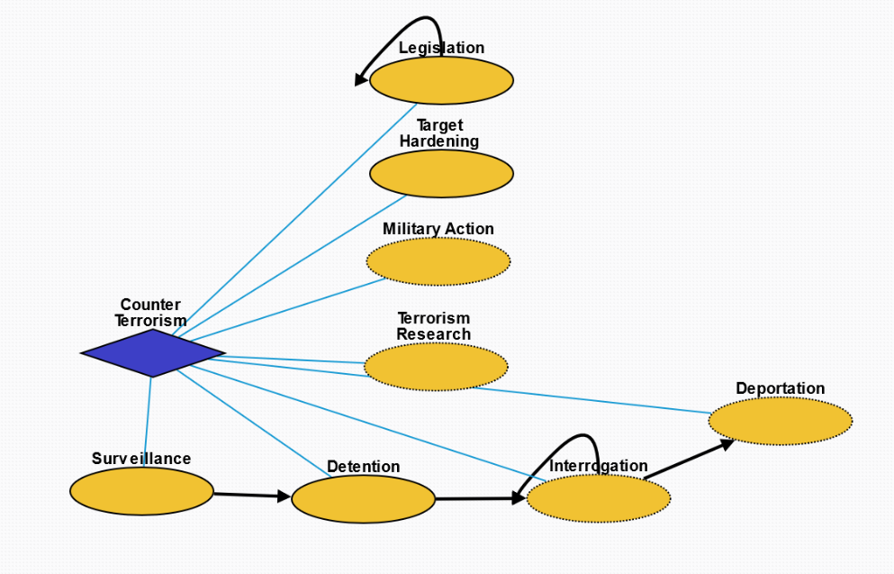
Counter Terrorism
Legislation: Laws enacted against terrorism.
Target Hardening: Process of securing or strengthening security of an area suspected to be targeted by terrorism.
Military Action: Control of people by others through violence in order to prevent further terrorist activity.
Terrorism Research: Systematic research into the cause of terrorism and its impact as well as preventative measures.
Surveillance: Monitoring of behavior, activities, or other changing information, for the purpose of influencing, managing or directing.
Detention: Removal of the freedom of liberty by a state.
Interrogation: Interviewing employed by law enforcement officers, military personnel, and intelligence agencies with the goal of eliciting information about affiliation with any terrorist group.
Deportation: Expulsion of the people from a place or country.

